Slide 1

An Evaluation Study on Log Parsing and Its Use in Log Mining
Pinjia He, Jieming Zhu, Shilin He, Jian Li, Michael R. Lyu
Supervisor: Prof. Michael R. Lyu

Slide 2


System reliability is very important
System
Failures
Notes:
http://www.cbronline.com/BRHome/ResizeImage/_Uploads_NewsArticle_4159576_main.jpg/1024/1024/Details/0/0
http://www.autorentalnews.com/fc_resources/ARN%20Nov-Dec%2009%20faucet.jpg

Slide 3


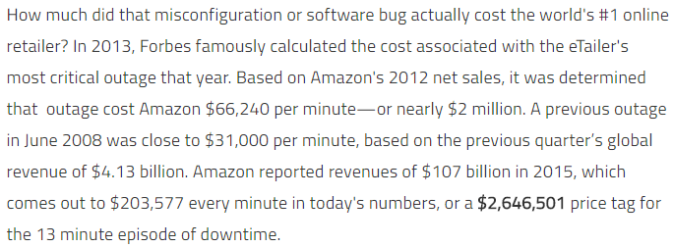
Real-World Revenue Loss
Notes:
http://www.datacenterdynamics.com/power-cooling/one-minute-of-data-center-downtime-costs-us7900-on-average/83956.fullarticle
http://www.theatlantic.com/technology/archive/2014/10/facebook-is-losing-24420-per-minute/382054/
The study of US data centers: 2013
Facebook: 2014
Amazon: 2016

Slide 4
Logs are widely-employed to enhance the system reliability by
log analysis

Slide 5
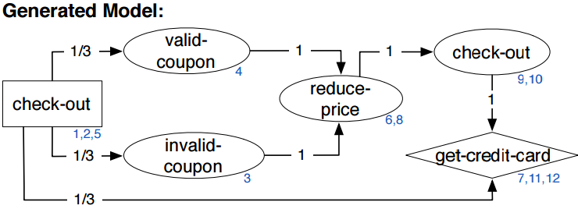
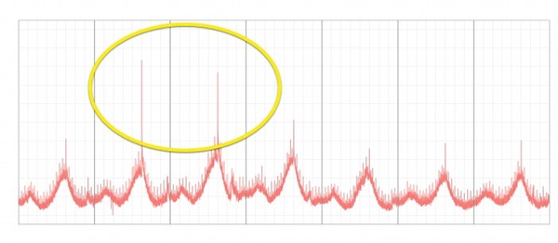

Log Analysis
Leveraging existing instrumentation to automatically infer invariant-constrained models [FSE’11]
Assisting developers of big data analytics applications when deploying on hadoop clouds [ICSE’13]
Program Verification
Detecting largescale system problems by mining console logs [SOSP’09]
Log Clustering based Problem Identification for Online Service Systems [ICSE’16]
Anomaly Detection
Structured comparative analysis of systems logs to diagnose performance problems [NSDI’12]
Be conservative: enhancing failure diagnosis with proactive logging [OSDI’12]
Performance Monitoring

Slide 6
Log Analysis contains two steps:
Log Parsing and Log Mining

Slide 7
Log Parsing Example
2008-11-11 03:41:48 Received block blk_90 of size 67108864 from /10.250.18.114
Raw Log
Log Parsing
Field of Interest
Structured
Log
blk_90 -> Received block * of size * from *
Log Event
Notes:
What is log? (used by developers and operators to record runtime information)

Slide 8
Log Parsing Example
2008-11-11 03:41:48 Received block blk_90 of size 67108864 from /10.250.18.114
Raw Log
Log Parsing
Structured
Log
blk_90 -> Received block * of size * from *
The goal of log parsing is to distinguish between constant part and variable part from the log contents.
Notes:
可以一步步出来，给一个真实例子

Slide 9
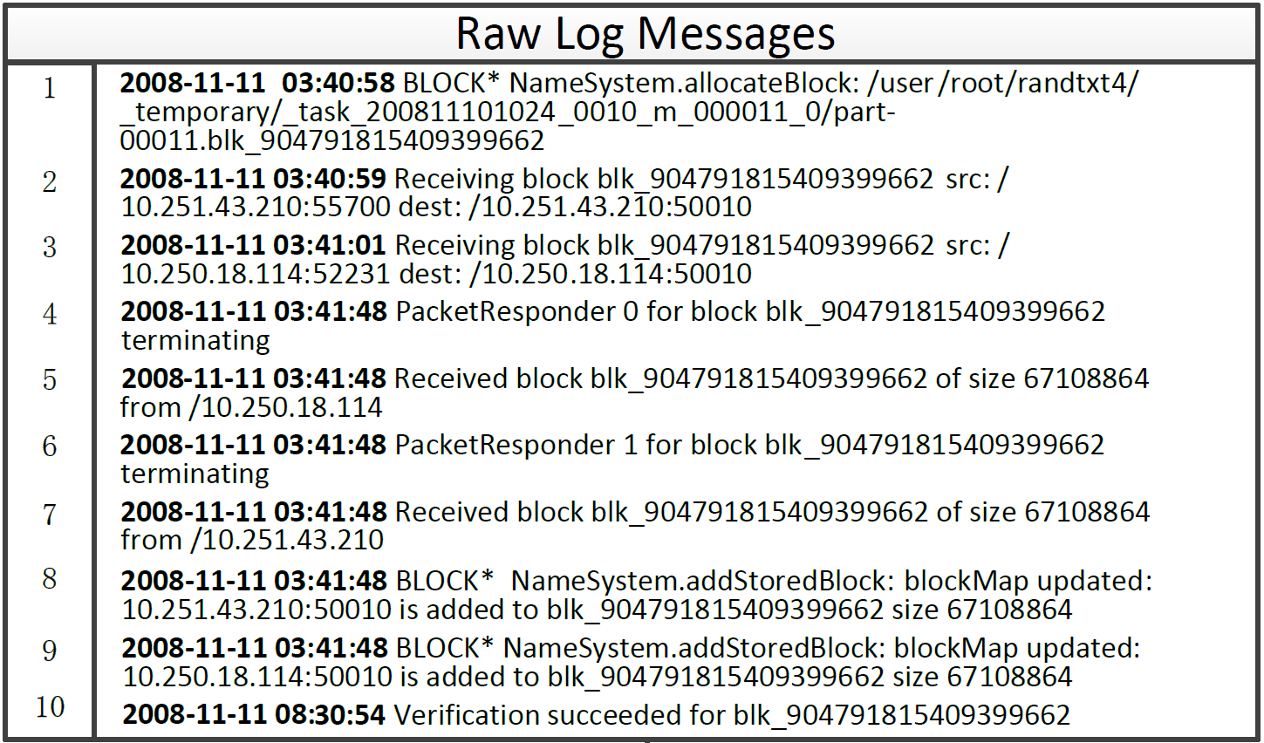
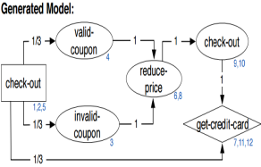
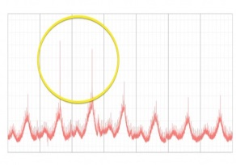

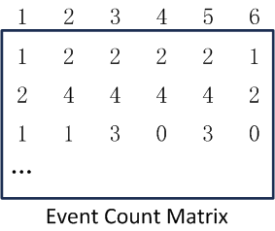
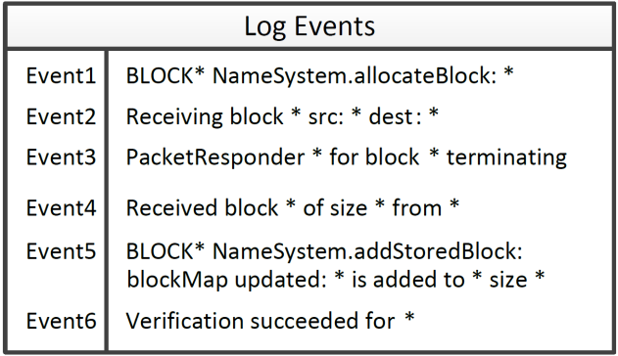
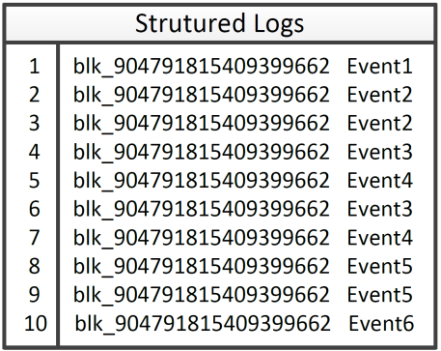
Log Analysis: log parsing & log mining
Log Mining
Log Parsing
Log Event
Block ID
Matrix
Generation
Notes:
可以一步步出来，给一个真实例子

Slide 10
Why evaluation study on log parsing methods?

Slide 11
Motivation and Contribution
2 findings
Developers are unaware of the accuracy and efficiency of different log parsing methods.
Developers do not know the impact of log parsers on subsequent log mining tasks.
Developers have to re-implement or even re-design a new log parser
2 findings
2 findings
We obtain 6 insightful findings by evaluating the performance of 4 log parsing methods on 5 data sets.
We implement 4 log parsing methods and make them open-source for reuse.
Notes:
列出paper里写的两条

Slide 12
State-of-the-art Log Parsing Methods
SLCT: Simple Logfile Clustering Tool [IPOM’03]
IPLoM: Iterative Partitioning Log Mining [KDD’09, TKDE’12]
LKE: Log Key Extraction [ICDM’09]
LogSig: Log Signature Extraction [CIKM’11]
Heuristic Rules
Clustering Algorithms

Slide 13
Evaluation
RQ1: What is the accuracy of the state-of-the-art log parsing methods?
RQ2: How do these log parsing methods scale with the volume of logs?
RQ3: How do different log parsers affect the results of log mining?

Slide 14
Evaluation
RQ1: What is the accuracy of the state-of-the-art log parsing methods?
RQ2: How do these log parsing methods scale with the volume of logs?
RQ3: How do different log parsers affect the results of log mining?

Slide 15
RQ1: Accuracy RQ2: Efficiency RQ3: Impact on log mining
RQ1: What is the accuracy of the state-of-the-art log parsing methods?
RQ2: How do these log parsing methods scale with the volume of logs?
RQ3: How do different log parsers affect the results of log mining?

Slide 16
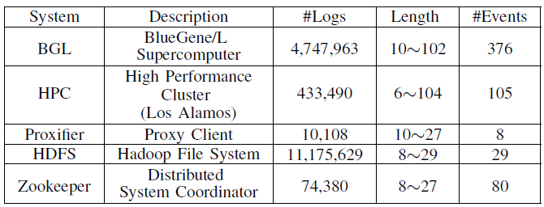
RQ1: Accuracy RQ2: Efficiency RQ3: Impact on log mining
Data set (supercomputer, distributed system, standalone software)
Randomly select 2,000 logs from each data set
[DSN’07]
[TKDE’12]
[SOSP’09]

Slide 17
RQ1: Accuracy RQ2: Efficiency RQ3: Impact on log mining
Accuracy: F-measure of clustering algorithm
TP: assigns two logs with the same log event to the same cluster
TN: assigns two logs with different log events to different clusters
FP: assigns two logs with different log events to the same cluster
FN: assigns two logs with the same log events to different clusters
Precision = TP/(TP+FP) Recall = TP/(TP+FN)
F-measure = 2 * Precision * Recall / (Precision + Recall)

Slide 18
RQ1: Accuracy RQ2: Efficiency RQ3: Impact on log mining
 | BGL | HPC | HDFS | Zookeeper | Proxifier
SLCT | 0.61 | 0.81 | 0.86 | 0.92 | 0.89
IPLoM | 0.99 | 0.64 | 0.99 | 0.94 | 0.90
LKE | 0.67 | 0.17 | 0.57 | 0.78 | 0.81
LogSig | 0.26 | 0.77 | 0.91 | 0.96 | 0.84
Finding 1: Current log parsing methods achieve high overall parsing accuracy (F-measure).
Notes:
把大于0.8的下面，用一个下划线强调一下

Slide 19
RQ1: Accuracy RQ2: Efficiency RQ3: Impact on log mining
Preprocess the raw logs. (remove IP addresses in HPC & Zookeeper & HDFS, core IDs in BGL, and block IDs in HDFS)
 | BGL | HPC | HDFS | Zookeeper | Proxifier
SLCT | 0.61/0.94 | 0.81/0.86 | 0.86/0.93 | 0.92/0.92 | 0.89/-
IPLoM | 0.99/0.99 | 0.64/0.64 | 0.99/1.00 | 0.94/0.90 | 0.90/-
LKE | 0.67/0.70 | 0.17/0.17 | 0.57/0.96 | 0.78/0.82 | 0.81/-
LogSig | 0.26/0.98 | 0.77/0.87 | 0.91/0.93 | 0.96/0.99 | 0.84/-
Finding 2: Simple log preprocessing using domain knowledge (e.g. removal of IP address) can further improve log parsing accuracy.

Slide 20
RQ1: Accuracy RQ2: Efficiency RQ3: Impact on log mining
RQ1: What is the accuracy of the state-of-the-art log parsing methods?
RQ2: How do these log parsing methods scale with the volume of logs?
RQ3: How do different log parsers affect the results of log mining?

Slide 21
RQ1: Accuracy RQ2: Efficiency RQ3: Impact on log mining
Evaluate the running time of log parsing methods on all data sets by varying the number of raw logs.
BGL | 400 | 4k | 40k | 400k | 4m
HPC | 600 | 3k | 15k | 75k | 375k
HDFS | 1k | 10k | 100k | 1m | 10m
Zookeeper | 4k | 8k | 16k | 32k | 64k
Proxifier | 600 | 1200 | 2400 | 4800 | 9600

Slide 22
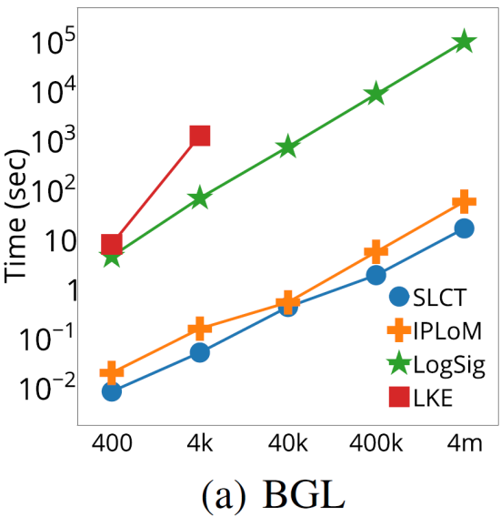
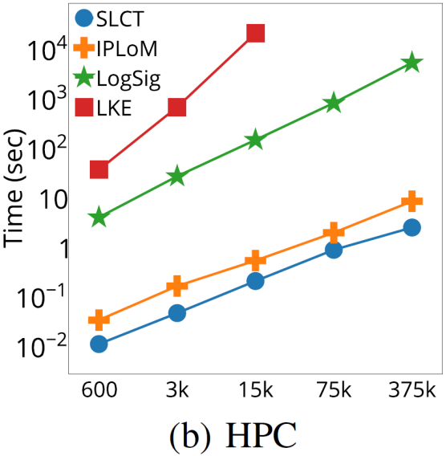
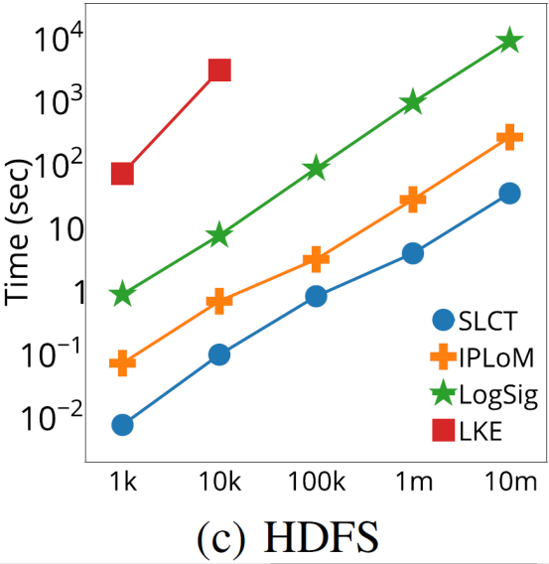
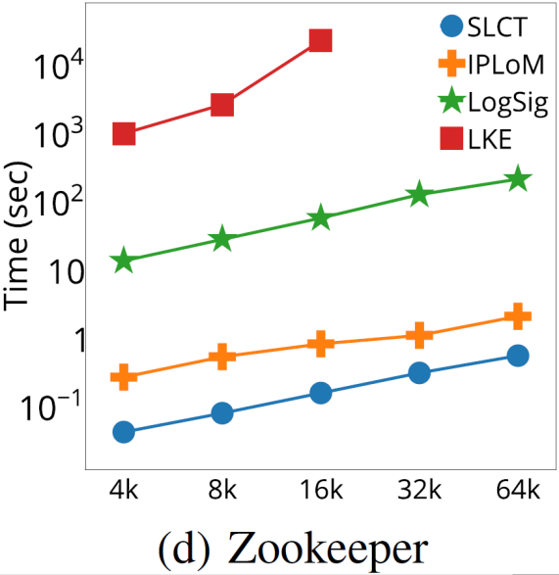
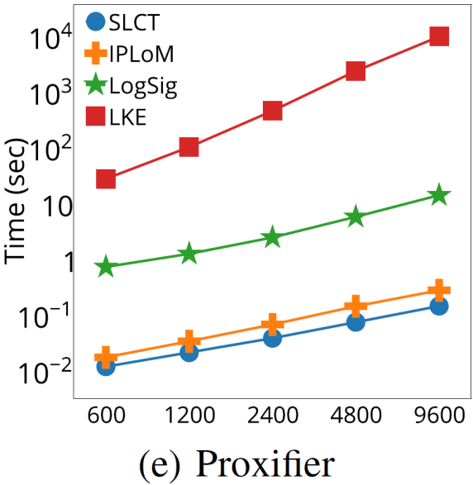
RQ1: Accuracy RQ2: Efficiency RQ3: Impact on log mining
Finding 3: Clustering-based log parsing methods could not scale well on large log data, which implies the demand for parallelization.
Notes:
提一下都是log scale

Slide 23
RQ1: Accuracy RQ2: Efficiency RQ3: Impact on log mining
The accuracy of log parser is affected by parameters, which should be set beforehand.
Use the parameters tuned on the 2,000 sample data sets, and evaluate the accuracy on data set with different size.
BGL | 400 | 4k | 40k | 400k | 4m
HPC | 600 | 3k | 15k | 75k | 375k
HDFS | 1k | 10k | 100k | 1m | 10m
Zookeeper | 4k | 8k | 16k | 32k | 64k
Proxifier | 600 | 1200 | 2400 | 4800 | 9600

Slide 24
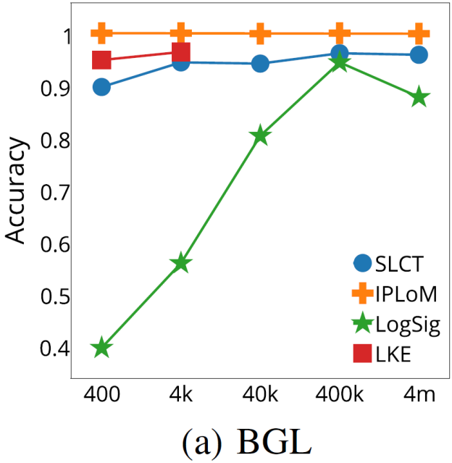
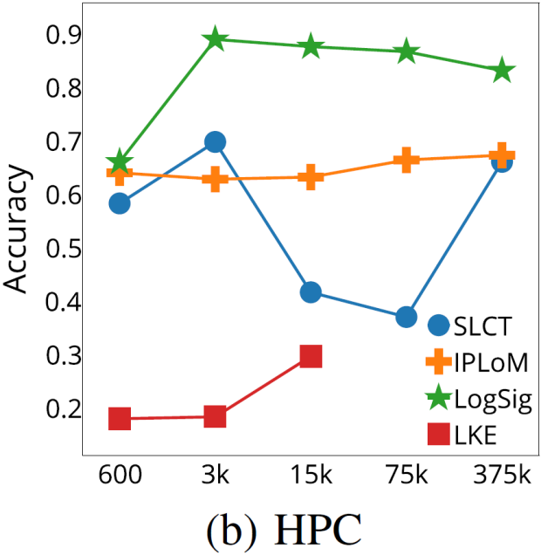
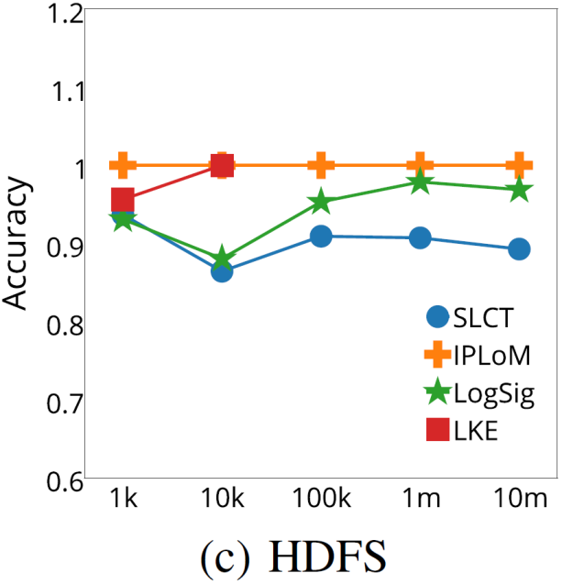
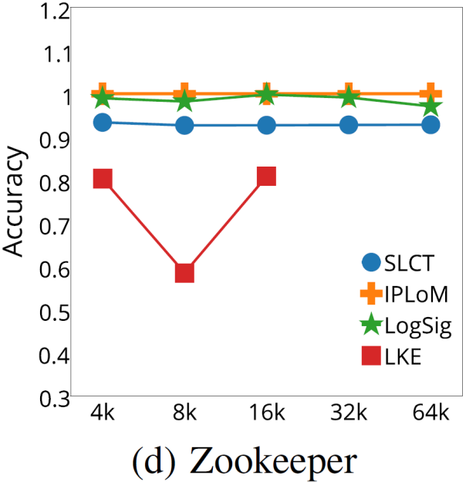
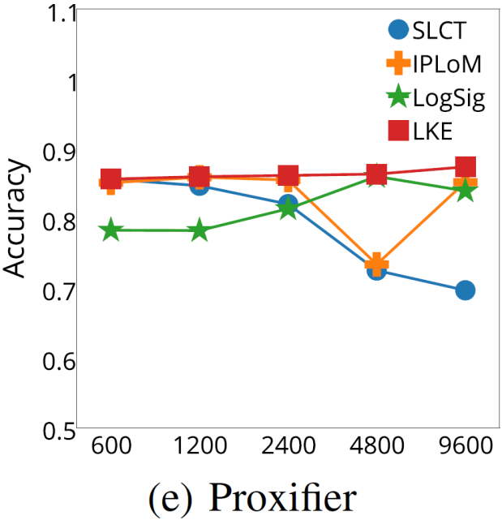
RQ1: Accuracy RQ2: Efficiency RQ3: Impact on log mining
Finding 4: Parameter tuning of log parsing methods is a time-consuming task, especially on large log datasets.

Slide 25
RQ1: Accuracy RQ2: Efficiency RQ3: Impact on log mining
RQ1: What is the accuracy of the state-of-the-art log parsing methods?
RQ2: How do these log parsing methods scale with the volume of logs?
RQ3: How do different log parsers affect the results of log mining?

Slide 26
RQ1: Accuracy RQ2: Efficiency RQ3: Impact on log mining
Evaluate the effectiveness of log parsing methods on log mining
Case study on real-world anomaly detection task [SOSP’09]
11,175,629 HDFS logs
575,061 HDFS blocks
16,838 anomalies

Slide 27
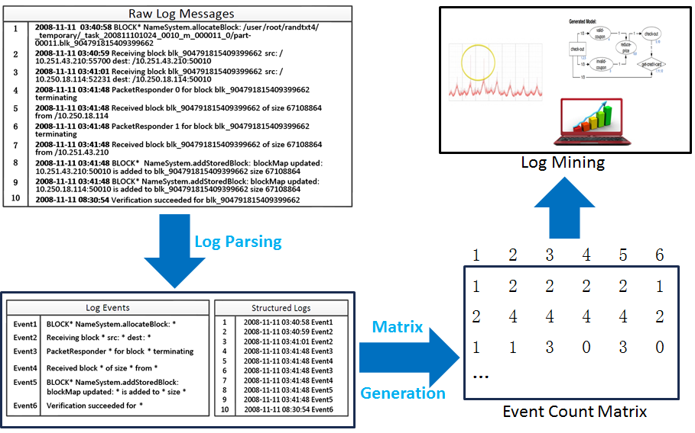
RQ1: Accuracy RQ2: Efficiency RQ3: Impact on log mining
Parse the raw logs use three log parsers respectively (SLCT, IPLoM, LogSig).
Generate event count matrix, where each row represent a block, each column is #occurrence of log event.
Use PCA-based anomaly detection method to detect anomalies [SIGCOMM’04, SOSP’09]

Slide 28
RQ1: Accuracy RQ2: Efficiency RQ3: Impact on log mining
SLCT
IPLoM
LogSig
Ground
Truth
Anomaly Detection
employing different log parsers
Will the performance of log parsers affect the anomaly detection results?

Slide 29
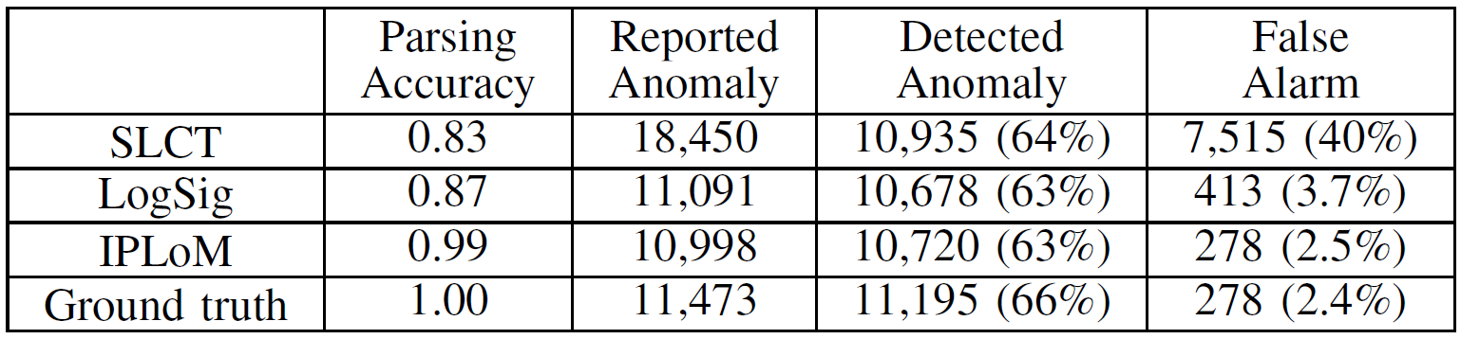
RQ1: Accuracy RQ2: Efficiency RQ3: Impact on log mining
Parsing Accuracy: F-measure\
Report Anomaly: #anomalies reported by PCA
Detected Anomaly: #true anomalies detected
False Alarm: #wrongly detected anomalies

Slide 30
RQ1: Accuracy RQ2: Efficiency RQ3: Impact on log mining
Finding 5: Log parsing is important because log mining is effective only when the parsing accuracy is high enough.

Slide 31
RQ1: Accuracy RQ2: Efficiency RQ3: Impact on log mining

Slide 32
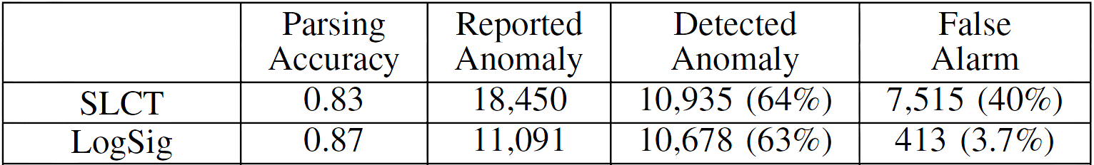
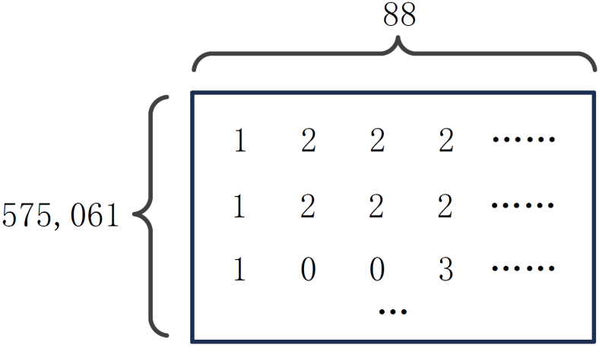
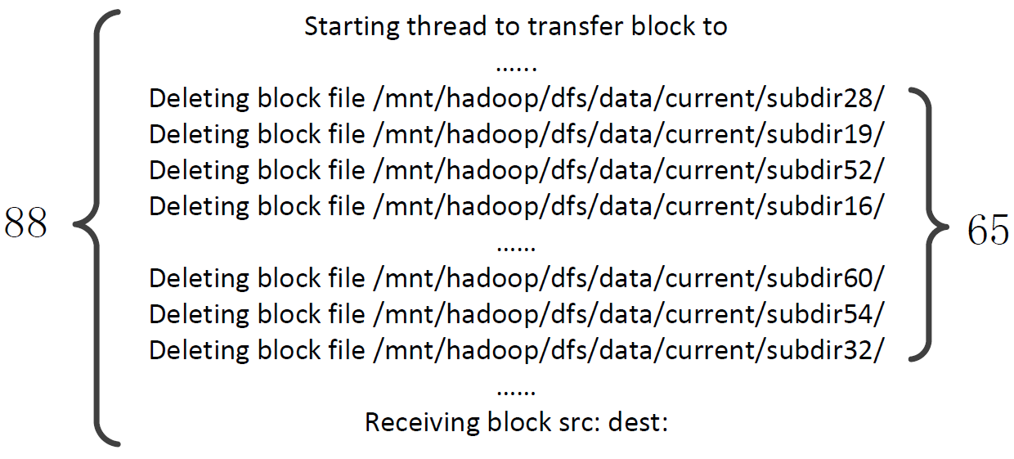
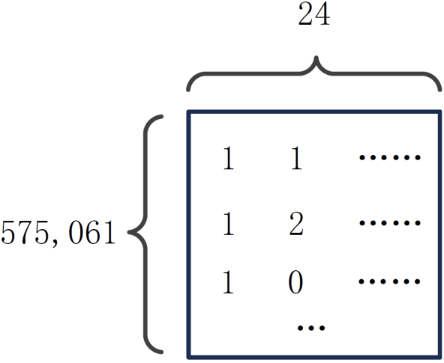
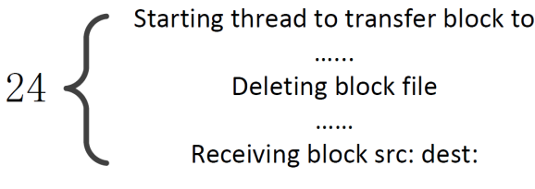
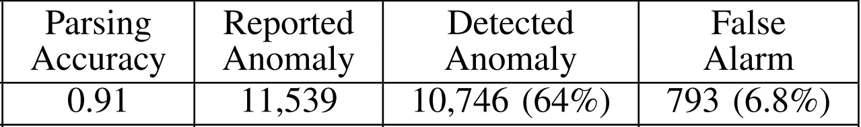
Original SLCT
SLCT
Refined
SLCT

Slide 33
Finding 6: Log mining is sensitive to some critical events. Errors in parsing 1 log event could even cause nearly an order of magnitude performance degradation in log mining.
SLCT

Slide 34
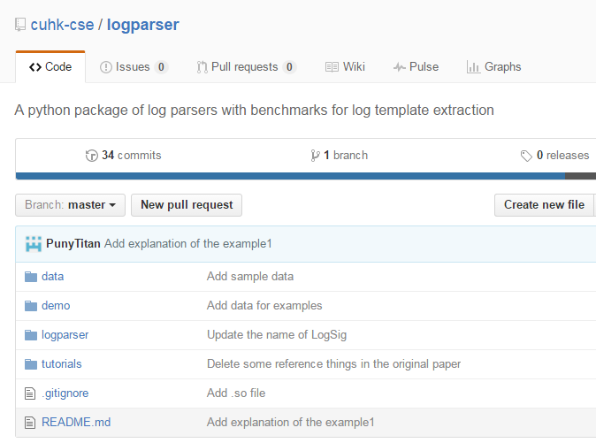
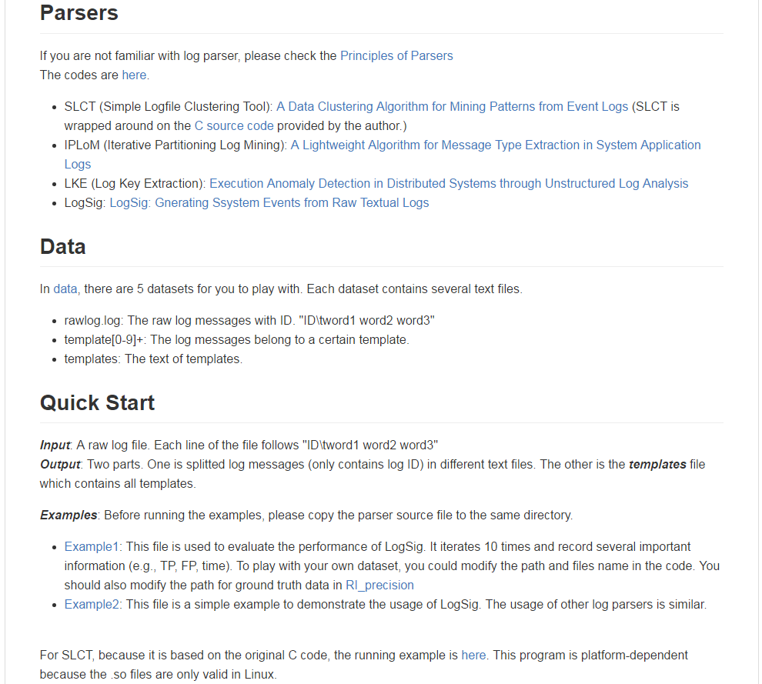
Parsers are open source on github.com/cuhk-cse/logparser

Slide 35
Conclusion
Conduct an evaluation study on four state-of-the-art log parsing methods in terms of accuracy and efficiency
A case study of the effectiveness of log parsing methods on log mining
Release the source code of the studied log parsers for reuse

Slide 36
Future work
Log parsing on large volume of logs
Parallel log parsers
Online log parsers
More log mining tasks
Failure classification
Program verification

Slide 37
Thank you!
Q&A
Find our parsers on github.com/cuhk-cse/logparser

Slide 38
SLCT
First work on automated log parsing, inspired by association rule mining.
Has been employed in event log mining [NOMS’08], symptom-based problem determination [CASCON’10], network alert classification [CNSM’10], etc.
(1)
(2)
(3)
Word Position Frequency
send file from port *
send file from port *
send 1 2000
Receiving block src * dest *
Receiving block src * dest *
port 4 2000
Verification succeed for *
……
send 2 100
Delete block *
……
……
Word vocabulary
Cluster candidates
Log event generation

Slide 39
IPLoM
Based on heuristic rules
Has been employed by event log analysis [IM’13], event summarization [SDM’14], etc.
(1)
(2)
(3)
(4)
Delete block blk_1
Delete block blk_1
Delete block blk_1
send file from port *
Delete block blk_2
Delete block blk_2
Delete block blk_2
Receiving block src * dest *
Verification succeed for blk_1
Send blk_1 time1
Remove block blk_3
……
Verification succeed for blk_2
Send blk_2 time2
Remove block blk_4
……
……
……
Partition by event size
Partition by word position
Partition by mapping (1-1, 1-M, M-M)
Log event generation

Slide 40
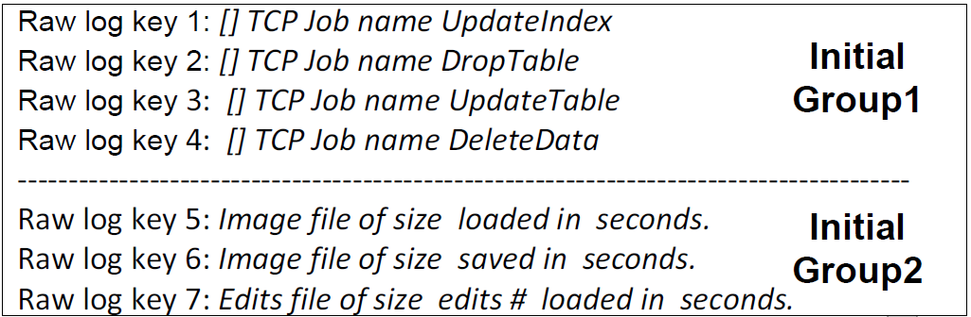
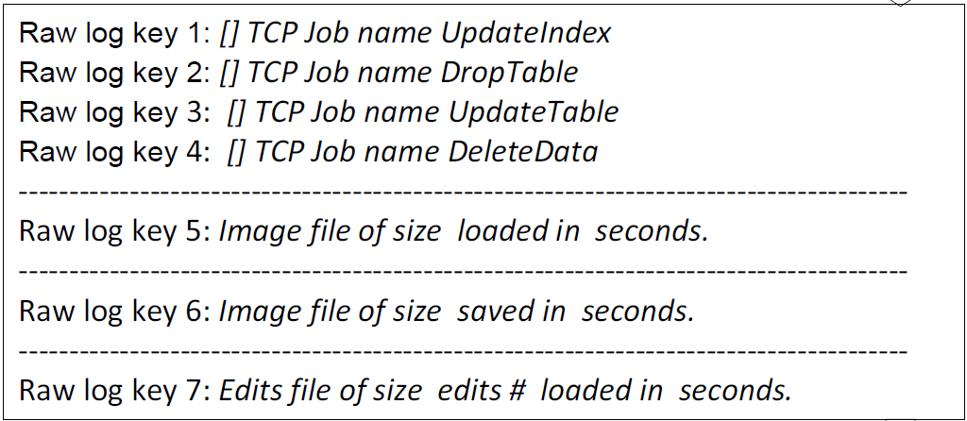
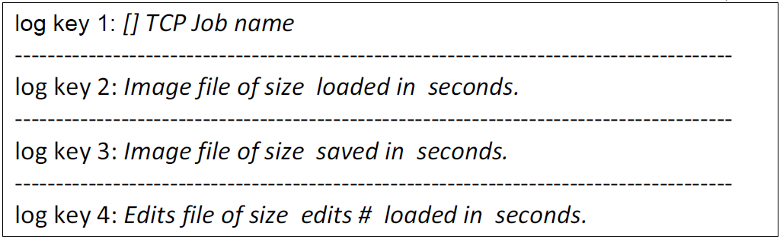
LKE
Developed by Microsoft
Based on clustering algorithm and heuristic rule
Log Clustering: Hierarchical clustering with customized weighted edit distance
Cluster Splitting: find longest common word sequence, split by heuristics
Log event extraction

Slide 41
LogSig
Tailored clustering algorithm inspired by K-means clustering
Has been employed in system monitoring [KDD’13]
(1)
(2)
Delete block blk_1
(3)
1. A potential value is calculated based on word pairs
send file from port *
(Delete, block) (Delete, blk_1)
Receiving block src * dest *
(block blk_1)
2. According to potential value, a log is assigned to a cluster
……
……
Log event generation
Word pair generation
3. Iterate until no cluster-changes occur
Log Clustering

Slide 42
Log Parsing is important, but challenging

Slide 43
Manual maintenance of log event is difficult, even with the help of regular expression
The volume of log is growing rapidly. For example, at a rate of around 50 gigabytes (120~200 million lines) per hour [Mi TPDS’13]
Developer may not understand the logging purpose. Modern systems often integrate open source software components written by hundreds of developers [Xu SOSP’09]
Log printing statements in modern systems update frequently. For example, a system in Google encounters tens or even hundreds of new log printing statements every month independent of the development stage [Xu PhD Thesis’10]
Notes:
ASE里写的三点

